Slide 1
PDFBox
Charlie Boggus, Sean Walston, Carson Susich, Kyle Kempf, Kyrne Beauford

Slide 2
Purpose
PDF conversion is an everyday occurence in business. However safe conversion is not.
Our product aims to bridge the gap between the two by providing safe and reliable PDF conversion
PDFBox provides quick and easy conversion of Microsoft Word, Powerpoint and Excel documents to PDF
We aim to become the one stop shop for safe, easy, and reliable PDF conversion eliminating the need to purchase expensive software or place important business documentation in the hands of an unsafe site.
With PDFBox we aim to give power back to the users, eliminating a roadblock in the users quest to success

Slide 3
The Users
Ease of use is key:
We provide a method for quick and easy document conversion
Designed with 3 clicks mentality, meaning a user can find what they are looking for within 3 clicks
Large focus on security:
We use HMAC SHA512 encryption to protect user information, as well as preserve the safety of their documents
Minimal invasiveness:
While our primary form of monetization is in the form of ads, they are designed to be minimally invasive to provide the best user experience
No pop-ups or intrusive ads are ever used on the site because we believe the user always comes first

Slide 4
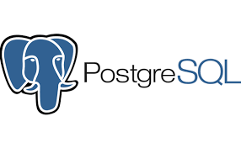
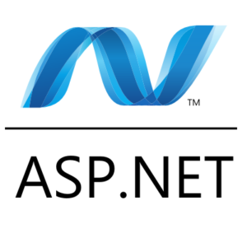

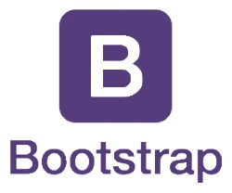
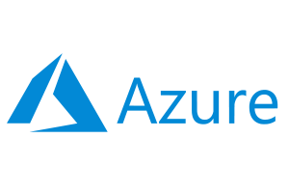
Architecture: Overview

Slide 5
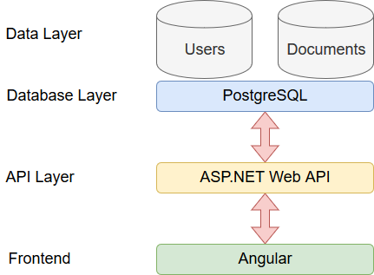
Architecture: Overview

Slide 6
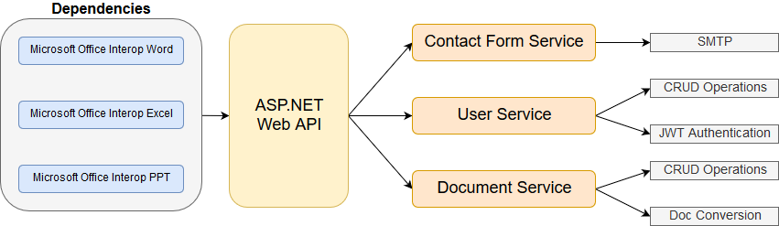
Architecture: API Overview

Slide 7
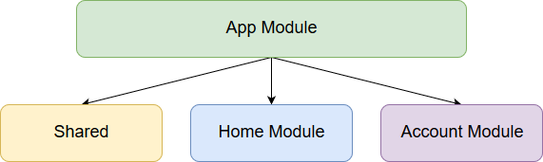
Architecture: Frontend Overview

Slide 8
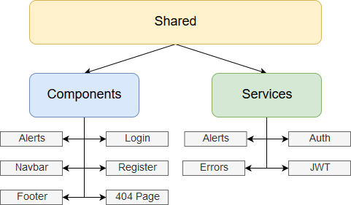
Architecture: Frontend Overview

Slide 9
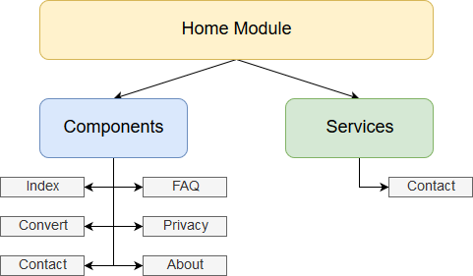
Architecture: Frontend Overview

Slide 10
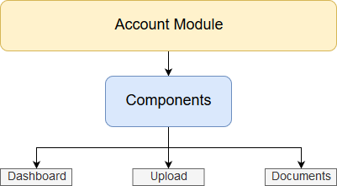
Architecture: Frontend Overview

Slide 11
Architecture: Design Decisions
Microsoft Office Interop Libraries:
Free libraries to interface with the Microsoft Office suite from a C# application
Unfortunately, these libraries do not work in a server environment due to them requiring and executing a local installation of office every time they are used
Since we’re poor college students, though, this was our only option for the purposes of this project
In a professional setting (with actual money to spend on proprietary libraries) we’d use the Aspose libraries which cost $2000+ for a license

Slide 12
Architecture: Requirements
Availability:
The system should have standard availability that most users expect from a website (24/7)
Performance:
The system should perform reasonably fast
Users do not want to wait 30 minutes for a document to be uploaded/converted
Reliability:
The system should reliably convert the supported documents to PDF. Basically, when a user uploads and converts a .docx, they should expect to get a valid .pdf file in return
The system should reliably store user data and documents. Loss of data on this platform would be unacceptable as it is essentially a cloud-storage platform.

Slide 13
Architecture: Requirements (cont.)
Scalability:
Due to the simplistic design of the application it is easily scalable to different types of demand
No limits on the amount of users or documents that can be stored in DB
No slowdowns from large amounts of traffic (web traffic or api request/operation traffic)
Security:
PDFBox stores sensitive user data (such as usernames, emails, and passwords)
Password information is encrypted using HMAC SHA512 encryption
Usability:
The design of PDFBox is simple, minimalistic, and easy to use
Users should not be confused about what does what so we’ve minimized all possibility for confusion

Slide 14
Outcomes
Measures of success:
Monthly users and growth rate per month
Site traffic, traffic sources, bounce rate
Ad real estate availability and clicks per ad

